Slide 1
GESTURE CONTROLLED WHEELCHAIR
Project report
ADARSH . G . KRISHNAN

Slide 2
CONTENTS
INTRODUCTION
COMPONENTS REQUIRED
Circuit Diagram and Explanation

Slide 3
Working
Program code and explanation
Future scope and conclusion

Slide 4
INTRODUCTION
A gesture controlled robot is controlled by using hand in place of any other method like buttons or joystick. Here one only needs to move hand to control the robot. A transmitting device is used in your hand which contains RF Transmitter and accelero-meter. This will transmit command to robot so that it can do the required task like moving forward, reverse, turning left, turning right and stop. All these tasks will be performed by using hand gesture.

Slide 5
COMPONENTS REQUIRED
Arduino UNO
ARDUINO IDE
Motor Driver L293D/DC Motors
Accelerometer
HT12D IC
HT12E IC
9 Volt Battery
Battery Connector
USB cable
Robot Chasis
LM324 IC
RF Pair

Slide 6
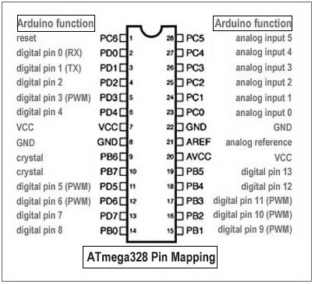
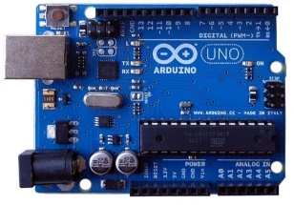
ARDUINO UNO
Arduino UNO is a microcontroller board based on the
ATmega-328
It has
  14 digital input/output pins(of which 6 can be used
  as PWM outputs)
  6 Analog inputs
  A 16 MHz crystal oscillator
  A USB connection, a power jack
  A reset button

Slide 7
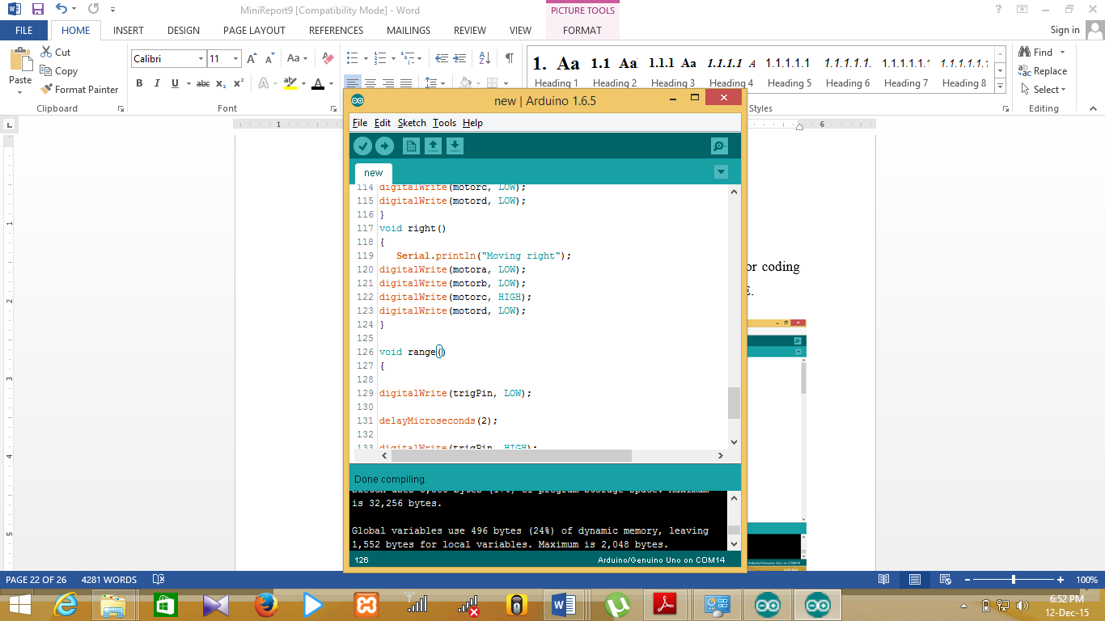
Arduino IDE
Open-source Arduino software(IDE) that makes easy to write code and upload it to the board
It runs on Windows, Mac OS X and Linux
It is a cross platform application written in Java
It includes a code editor with features such as syntax highlighting, brace matching and automatic indentation
It provides simple one-click mechanism for compiling and loading programs in to an Arduino board

Slide 8
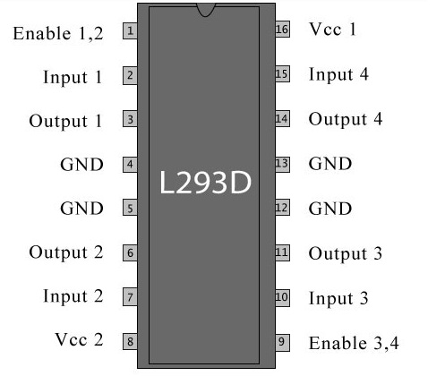
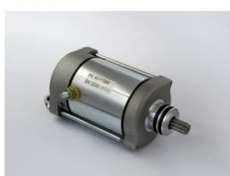
MOTOR DRIVER AND DC MOTORS
The L293D is a 16-pin IC with 8 pins on each side
It is dedicated to the controlling of a motor
An L293D can control 2 motors simultaneously
2 input pins,2 output pins and 1 enable pin for each motor
Motor Driver IC
DC MOTOR

Slide 9
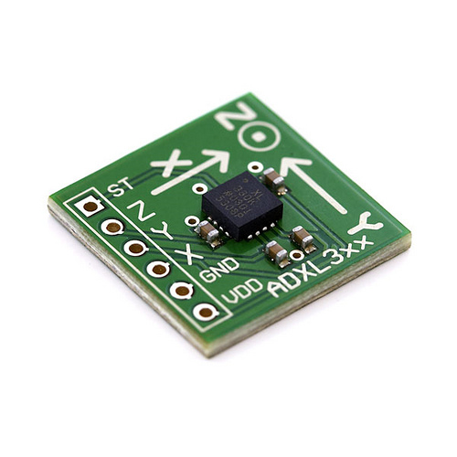
Accelerometer
Accelerometer is a 3 axis acceleration measurement device with +-3g range. This device is made by using polysilicon surface sensor and signal conditioning circuit to measure acceleration. The output of this device is Analog in nature and proportional to the acceleration. This device measures the static acceleration of gravity when we tilt it. And gives an result in form of motion or vibration.

Slide 10
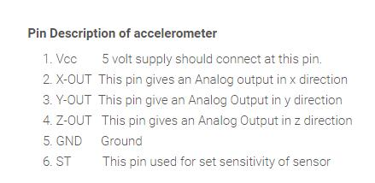
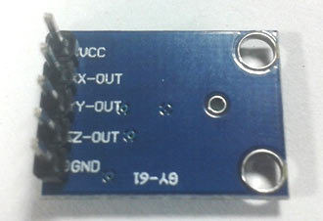
According to the datasheet of adxl335 polysilicon surface-micromachined structure placed on top of silicon wafer. Polysilicon springs suspend the structure over the surface of the wafer and provide a resistance against acceleration forces. Deflection of the structure is measured using a differential capacitor which incorporate independent fixed plates and plates attached to the moving mass. The fixed plates are driven by 180° out-of-phase square waves. Acceleration deflects the moving mass and unbalances the differential capacitor resulting in a sensor output whose amplitude is proportional to acceleration. Phase-sensitive demodulation techniques are then used to determine the magnitude and direction of the acceleration.

Slide 11
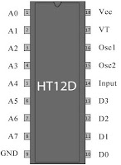
HT12D decoder IC
It is used convert serial data into parallel which is received by the RF receiver.
A valid transmission indicated by a high signal at VT pin

Slide 12
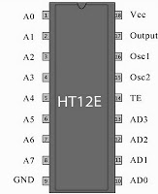
HT12e encoder IC
It is used to encode data or converting it into serial form and then send this data by using RF transmitter into the environment.

Slide 13
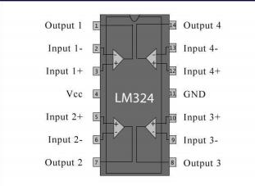
LM324 comparator IC
The comparator ic compares the analog voltage received from the accelerometer and compares it with a reference voltage and gives a particular high or low voltage. The received signal is quite noisy and of various voltage levels. This ic compares those levels and outputs in the form of 1 or 0 voltage level. This process is called signal conditioning.
LM324 IC

Slide 14
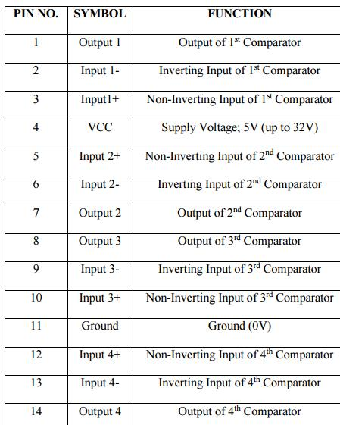
The pins 1, 7, 8 and 14 are output pins. A reference voltage is connected to the negative terminal for high output when input is high or positive terminal for high output when input is low from the LM324 IC.
PIN DESCRIPTION OF LM324

Slide 15
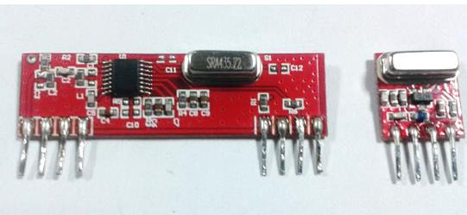
RF Pair
RF TRANSMITTER AND RECIEVER
RF Transmitter and Receiver pair is a low cost ideal solution for remote control applications. It is able to transmit data over 100 meters range. It is available in two frequencies, 315MHz and434MHz.

Slide 16
Circuit Diagram and Explanation
Gesture Controlled Robot is divided into two sections:
Transmitter part
Receiver part
In transmitter part an accelerometer and a RF transmitter unit is used. As we have already discussed that accelerometer gives an analog output so here we need to convert this analog data in to digital. For this purpose we have used 4 channel comparator circuit in place of any ADC. By setting reference voltage we gets a digital signal and then apply this signal to HT12E encoder to encode data or converting it into serial form and then send this data by using RF transmitter into the environment.
At the receiver end we have used RF receiver to receive data and then applied to HT12D decoder. This decoder IC converts received serial data to parallel and then read by using arduino. According to received data we drive robot by using two DC motor in forward, reverse, left, right and stop direction.

Slide 17
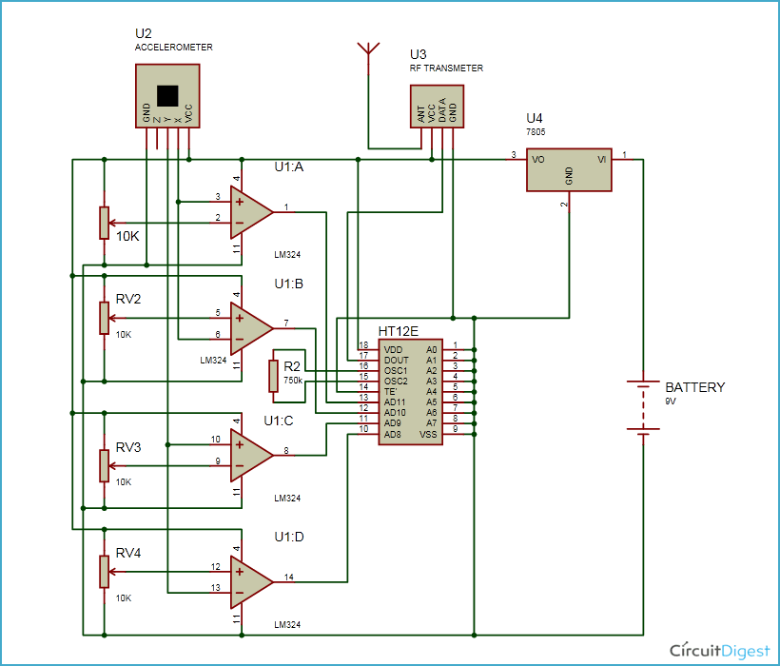
Transmitter part CIRCUIT

Slide 18
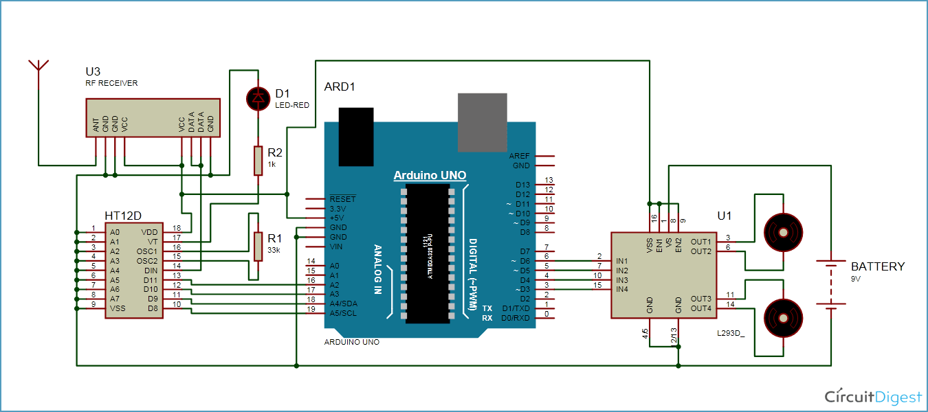
RECEIVER part CIRCUIT
Circuit for this hand gesture controlled robot is quite simple. As shown in above schematic diagrams, a RF pair is used for communication and connected with arduino. Motor driver is connected to arduino to run the robot. Motor driver’s input pin 2, 7, 10 and 15 is connected to arduino digital pin number 6, 5, 4 and 3 respectively. Here we have used two DC motors to drive robot in which one motor is connected at output pin of motor driver 3 and 6 and another motor is connected at 11 and 14. A 9 volt Battery is also used to power the motor driver for driving motors.

Slide 19
Working
Gesture controlled robot moves according to hand movement as we place transmitter in our hand. When we tilt hand in front side, robot start to moving forward and continues moving forward until next command is given.
When we tilt hand in backward side, robot change its state and start moving in backwards direction until other command is given.
When we tilt it in left side Robot get turn left till next command.
When we tilt hand in right side robot turned to right.
And for stopping robot we keeps hand in stable.

Slide 20
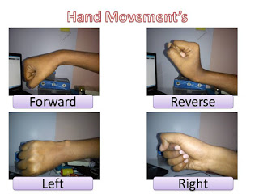

Slide 21
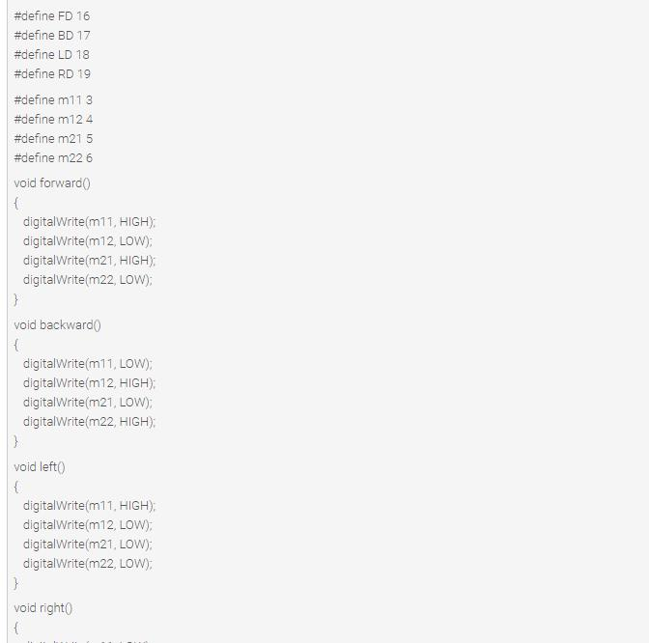
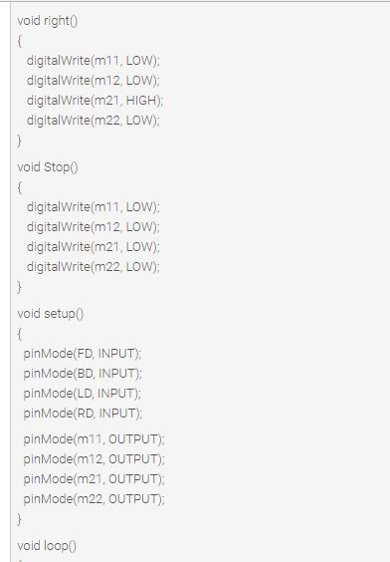
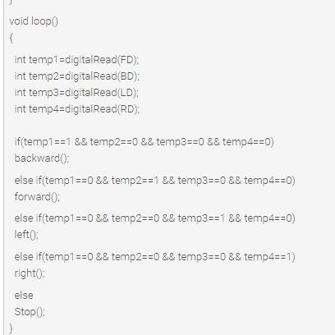
Program code and explanation

Slide 22
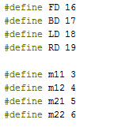
Program Explanation
In program first of all we have defined output pins for motors.

Slide 23
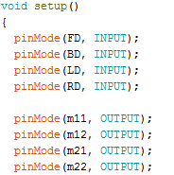
And then in setup we have given the directions to pin.

Slide 24
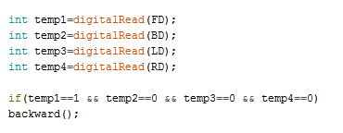
After this we read input by using ‘if statement’ and perform relative operation.

Slide 25
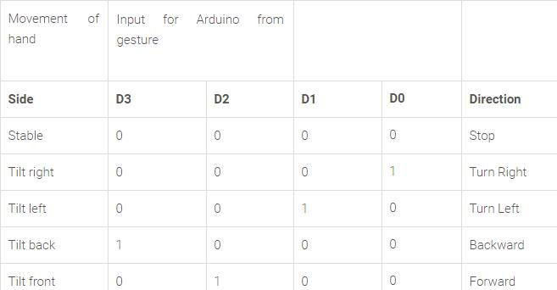
There are total five conditions for this Gesture controlled Robot which are giving below:

Slide 26
Future scope
Automated wheel chair can be operated by a wireless remote which can reduce the wiring arrangements
Instead of using acceleration motion we can use eye retina using optical sensor to move wheel chair accordingly
We can use voice command IC’s to interface our voice signal with micro-controller
This system can be extended by including GSM which sends an SMS during emergency
Research are going on development of handicap wheel chair using nervous system of human

Slide 27
conclusion
Automated wheel chair can be used to help handicapped people, especially those who are not able to move
The system was successfully implemented to move the wheel chair Left, Right, Forward, Backward or Stay in the same position.

Slide 28
<THANK YOU/>

